Slide 1
Comparison of the Monetary Choice Questionnaire and the Adjusting-Amount Procedure for Measuring Delay Discounting
Haoran (Matt) Wan
Dec. 8, 2021

Slide 2
Delay Discounting
Delay discounting refers to the decrease in the subjective (present) value of a reward as the time to its receipt increases.
Delay discounting is a growing area of research with implications for many socially important domains such as savings, investment, and health-related decisions.

Slide 4
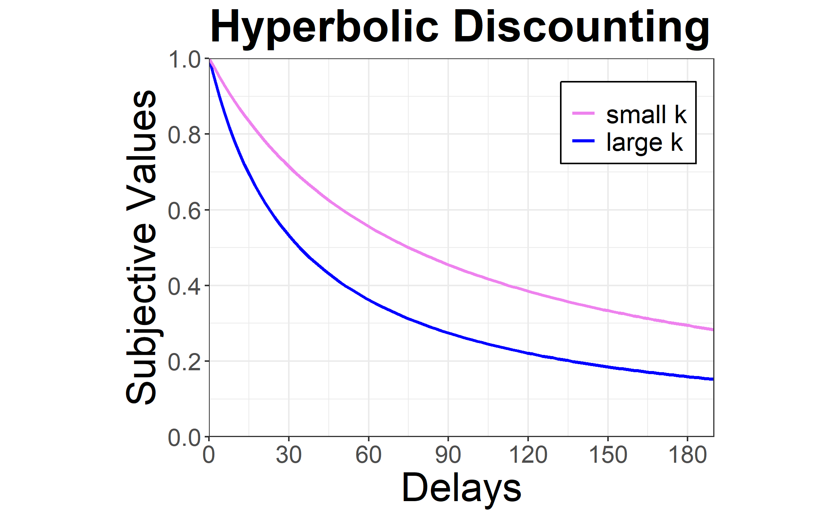

Hyperbolic Discounting Function
$$SV=\frac{A}{1+kD}$$
$SV$ – Subjective (present) value of the future reward
$A$ – Amount of the future reward
$D$ – Delay to the reward
$k$ – Discount rate parameter

Slide 5


$k$ and Impulsivity
Delay discounting is thought to underlie impulsive decision-making, and $k$ is viewed as representing ‘impulsivity’.
The discounting parameter, $k$, has been used to characterize delay discounting for groups and individual differences:
Larger values of $k$(steeper discounting) have been linked to smoking, alcohol and drug misuse, etc.

Slide 6
Measures of Delay Discounting
Two major measures of delay discounting:
Monetary Choice Questionnaire (MCQ)
Adjusting-Amount Delay Discounting Task
No comparison has been made between the MCQ and the adjusting-amount task for measuring delay discounting.
Purpose of this study:
To compare the MCQ to the adjusting-amount task and examine whether they measure the same underlying construct.

Slide 7
Method
A sample of 275 participants was recruited from Mturk.
(54.8% female; age: M = 34.8 years, SD = 10.4)
Participants completed both the MCQ and the adjusting-amount task.
The order of the two tasks were counterbalanced across participants.

Slide 8
MCQ
27 questions divided into three sets of amount:
$25-$35, $50-$60, $75-$85
Each question presented two options. One option was an immediate, smaller reward; the other option was a delayed, larger reward.

Slide 9
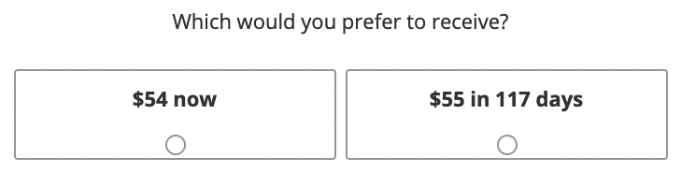
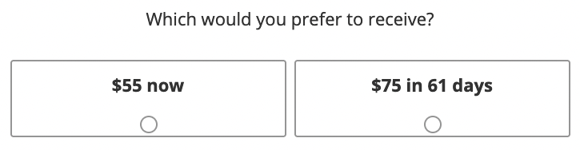
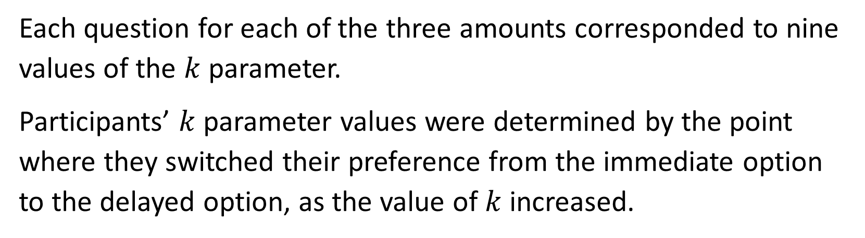
Each question for each of the three amounts corresponded to nine values of the $k$ parameter.
Participants’ $k$ parameter values were determined by the point where they switched their preference from the immediate option to the delayed option, as the value of $k$ increased.

Slide 10
Adjusting-Amount
Three delayed amount conditions: $30, $80, $500
Each delayed amount condition involved four delays: 7, 30, 90, and 180 days [and 730 days for $500].

Slide 11
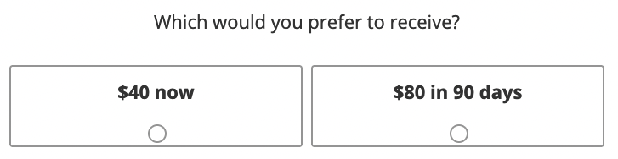

Slide 12
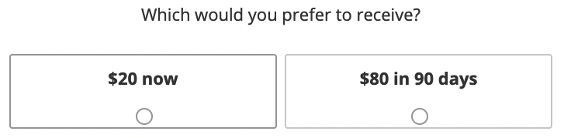

Slide 13
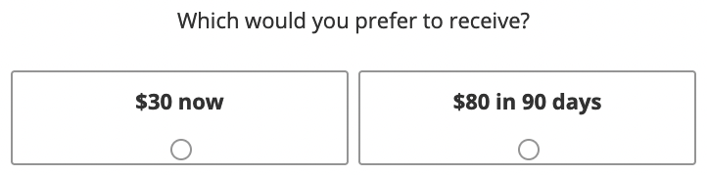

Slide 14

The amount of the immediate reward was adjusted until it was judged equal in value to that of the delayed reward (the indifference point).
Participants’ $k$ parameter was determined by fitting the hyperbolic discounting function to the obtained indifference points.

Slide 15

Data Analysis
Participants’ responses were modeled using Bayesian multilevel regression.
Our multi-level models consisted of individual-level and group-level estimations and assumed that the parameters that explained observed individual performances were drawn from an unknown population.
We assumed uniform priors for all regression for comparison purposes.

Slide 16
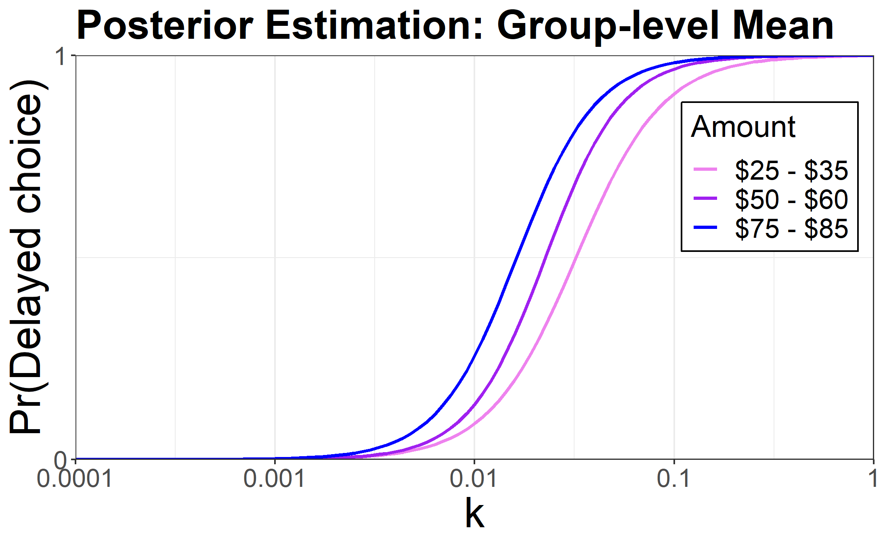

Results – MCQ Logistic regression
Choice of the delayed amount increased systematically as a function of the $k$for each amount.
Magnitude effect

Slide 17
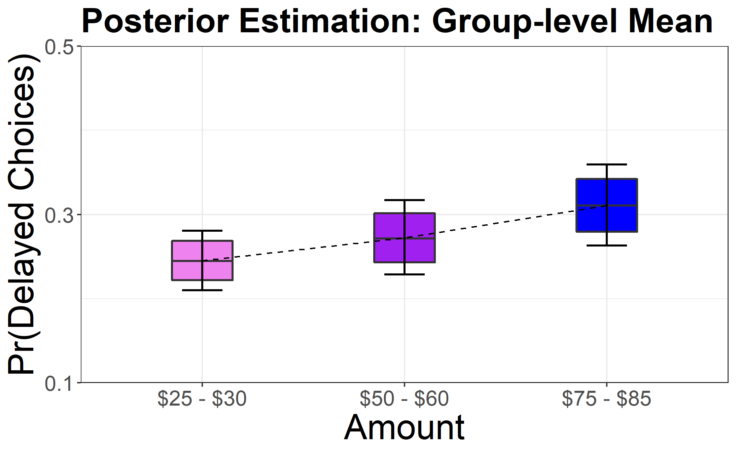
Results – MCQ Binomial Regression: Proportion of delayed choices

Slide 18
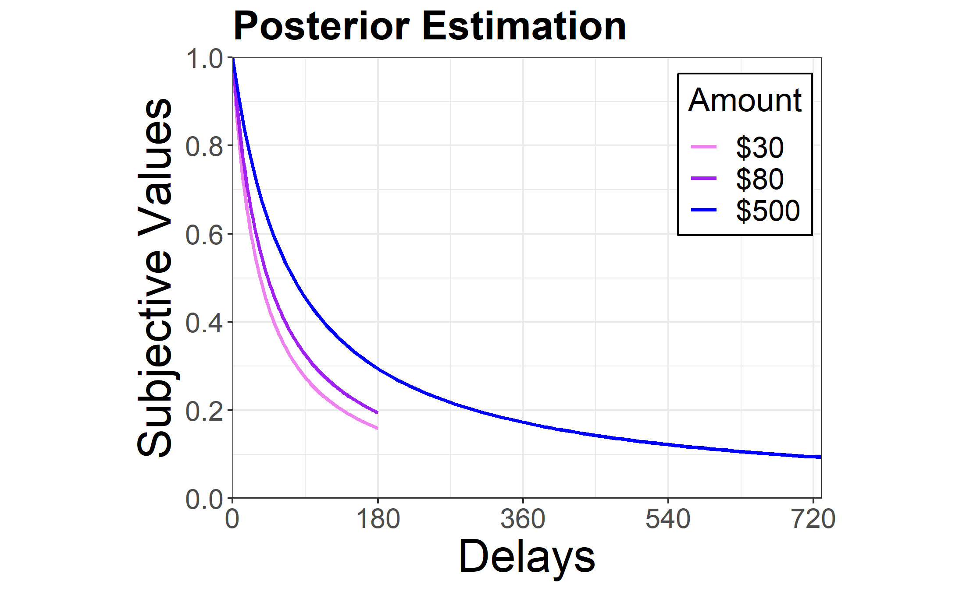
Results – Adjusting Amount Hyperbolic discounting
The subjective (present) value of the delayed reward decreased systematically as a function of delay, and also showed the magnitude effect.

Slide 19
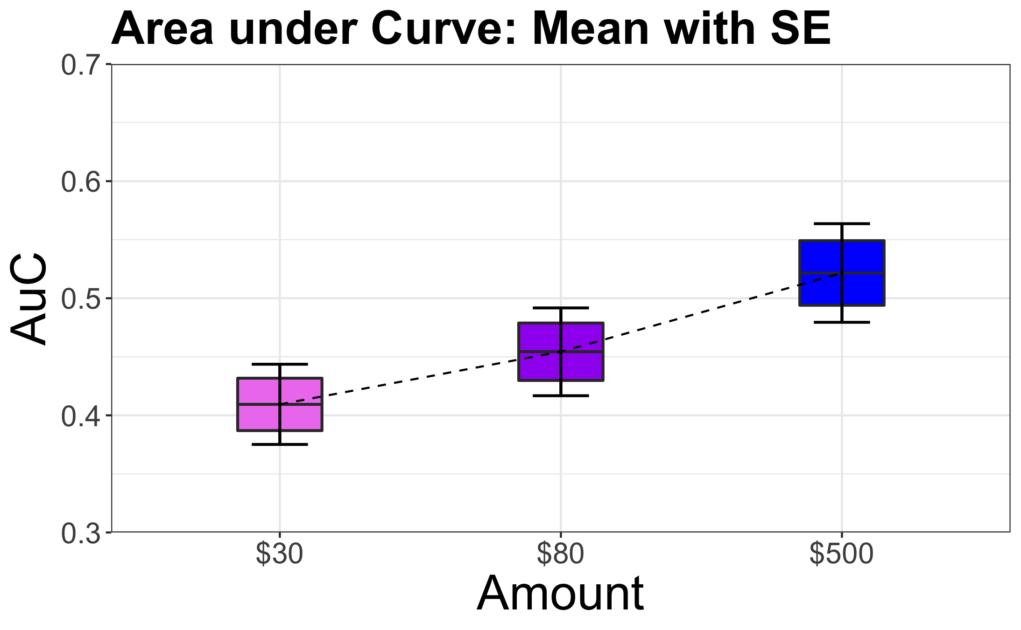
Results – Adjusting Amount Area under Curve (AuC)

Slide 20
Main Question
Do the MCQ and the adjusting-amount tasks measure the same underlying construct?

Slide 21
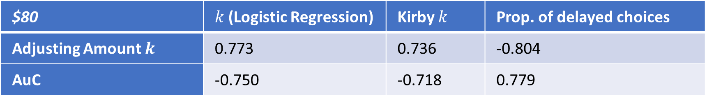
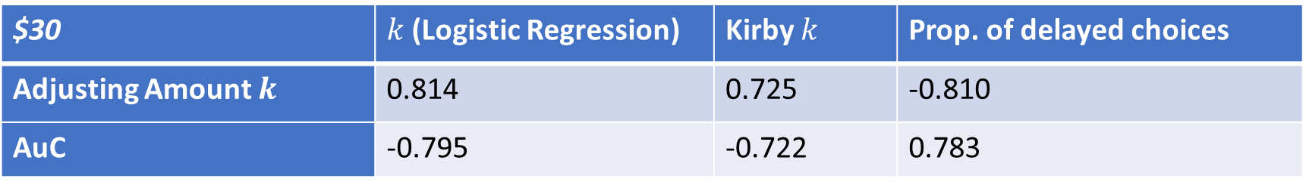
Comparisons between MCQ and Adjusting Amount Correlations among dependent variables for each task
$30 | $k$ (Logistic Regression) | Kirby $k$ | Prop. of delayed choices
Adjusting Amount $k$ | 0.814 | 0.725 | -0.810
AuC | -0.795 | -0.722 | 0.783
$80 | $k$ (Logistic Regression) | Kirby $k$ | Prop. of delayed choices
Adjusting Amount $k$ | 0.773 | 0.736 | -0.804
AuC | -0.750 | -0.718 | 0.779

Slide 22
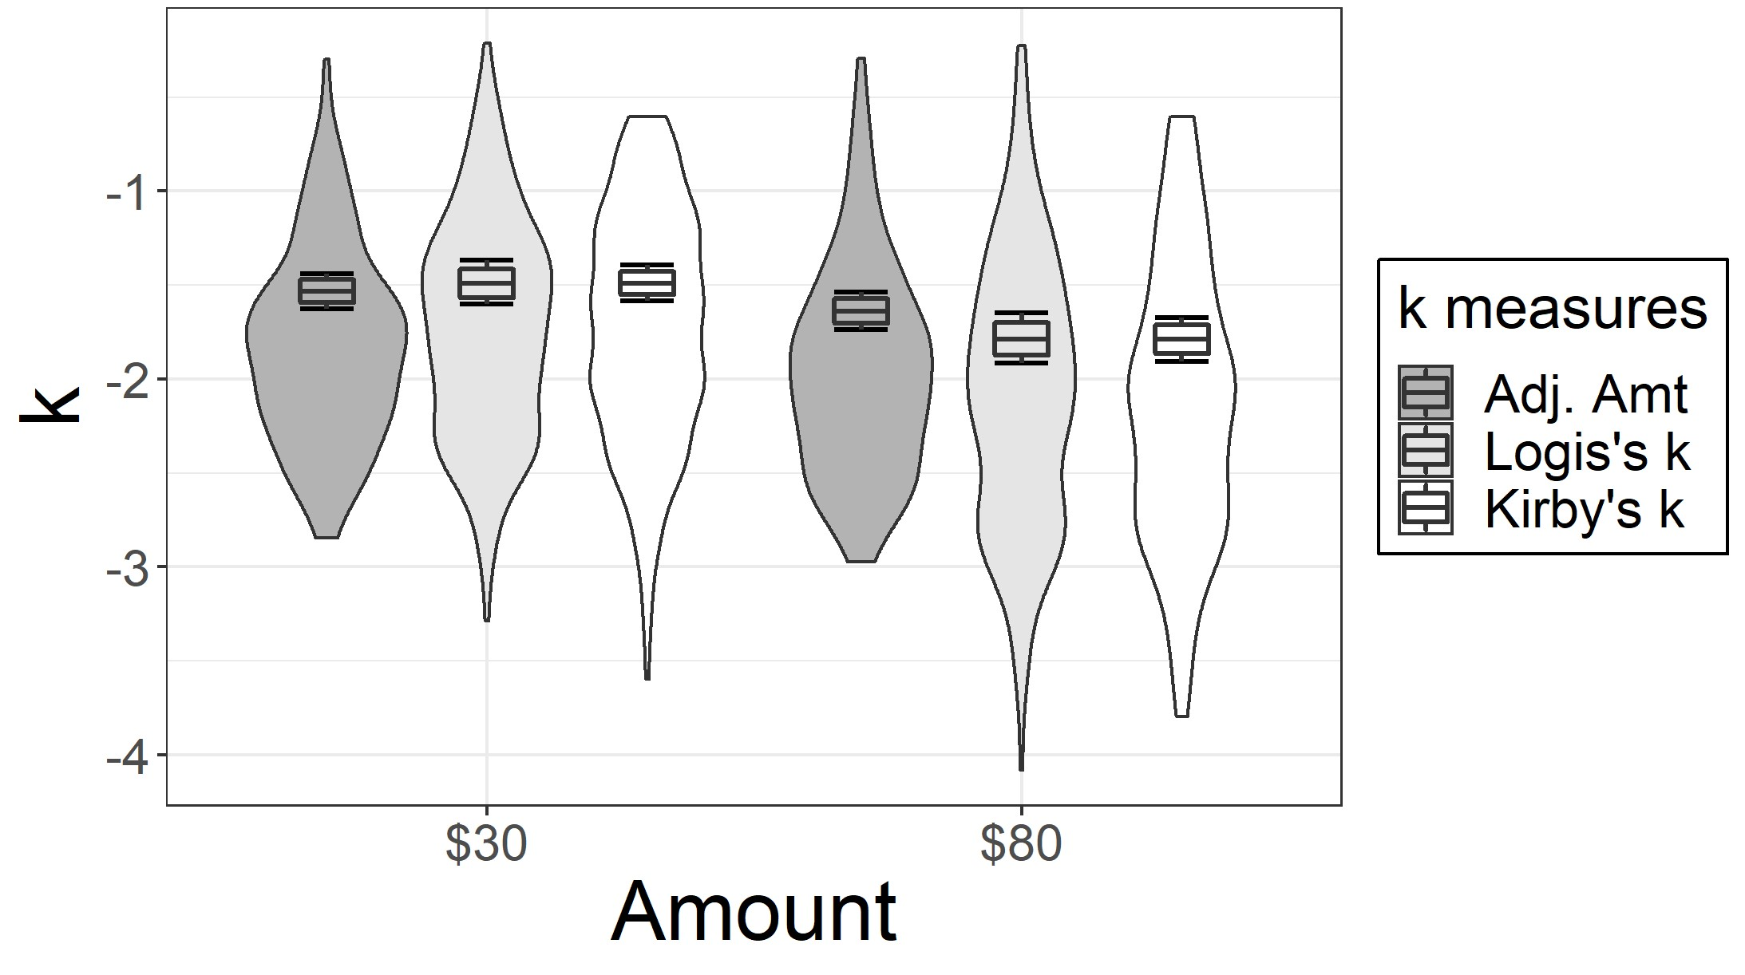
Comparisons between MCQ and Adjusting Amount Comparison among k values

Slide 23
Implications
Our findings suggest that the MCQ and adjusting-amount tasks measure the same underlying construct.
Future delay discounting studies, therefore, can choose either task depending on the research question of interest.

Slide 24
Bayesian multilevel modeling in discounting research
It is time-consuming to characterize a single participant’s discounting function.
With a proper Bayesian model, the data-per-participant can get arbitrarily small without the multi-level inference becoming invalid.

Slide 25
Future Directions
MTurk vs. Prolific
MCQ vs. Adjusting amount for delayed losses

Slide 26

Thank you!

